Slide 1

PORTABLE
MUSCLE STRENGTH ANALYZER
TEAM MEMBERS:
BHARGAV SRIRAM - 20BEE0196 SAI VIKHYAT -20BEE0240
ROSHAN KOVILAPATI - 20BEE0057
FACULTY CO-ORDINATOR: Prof. VIVEKANANDAN S
EEE1008 BIOMEDICAL INSTRUMENTATION
01

Slide 2
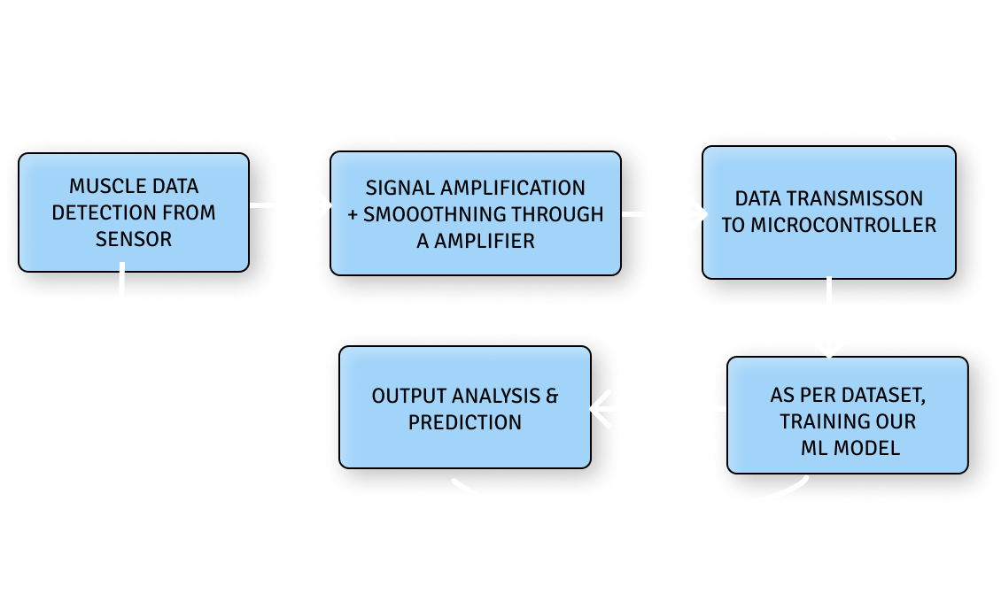
OBJECTIVE
02

Slide 3
- Muscle strength detection
03
data acquisition of muscles
sEMG - surface electromyography
Gesture detection algorithm
training a CNN to predict abnormalities
LITERATURE SURVERY:

Slide 4

Electromyography:
04
is a technique for evaluating and recording the electrical activity
produced by skeletal muscles
Microcontroller and EMG sensor:
METHODOLOGY:
Micro controller is used as receiving data from Amplifier, and EMG
sensor sends the data to Amplifer for smoothning.
Data Analysis and prediction:
Machine learning will be used for Data analysis & Prediction.

Slide 5
TIMELINE:
JAN 20th - DECIDED THE PROJECT JAN 26th - ORDERED COMPONENTS FEB 20th - HARDWARE COMPLETION FEB 21st - TEST RUN OF HARDWARE
MARCH 1st - MACHINE LEARNING ALGO MARCH 3rd - COMBINING HARDWARE & SOFTWARE
MARCH 15th - ADDONs MARCH 30th - FINAL RUN APRIL 20th- DOCUMENTATION

Slide 6
NOVELTY:
06
Portable
Cost effective
Similar model unavailable in the market Simple and easy to use
Includes gesture recognition (to find abnormalities).
It provides recommendations for muscle exercise Collecting data of a muscle and testing it with CNN to analyse muscle performance

Slide 7
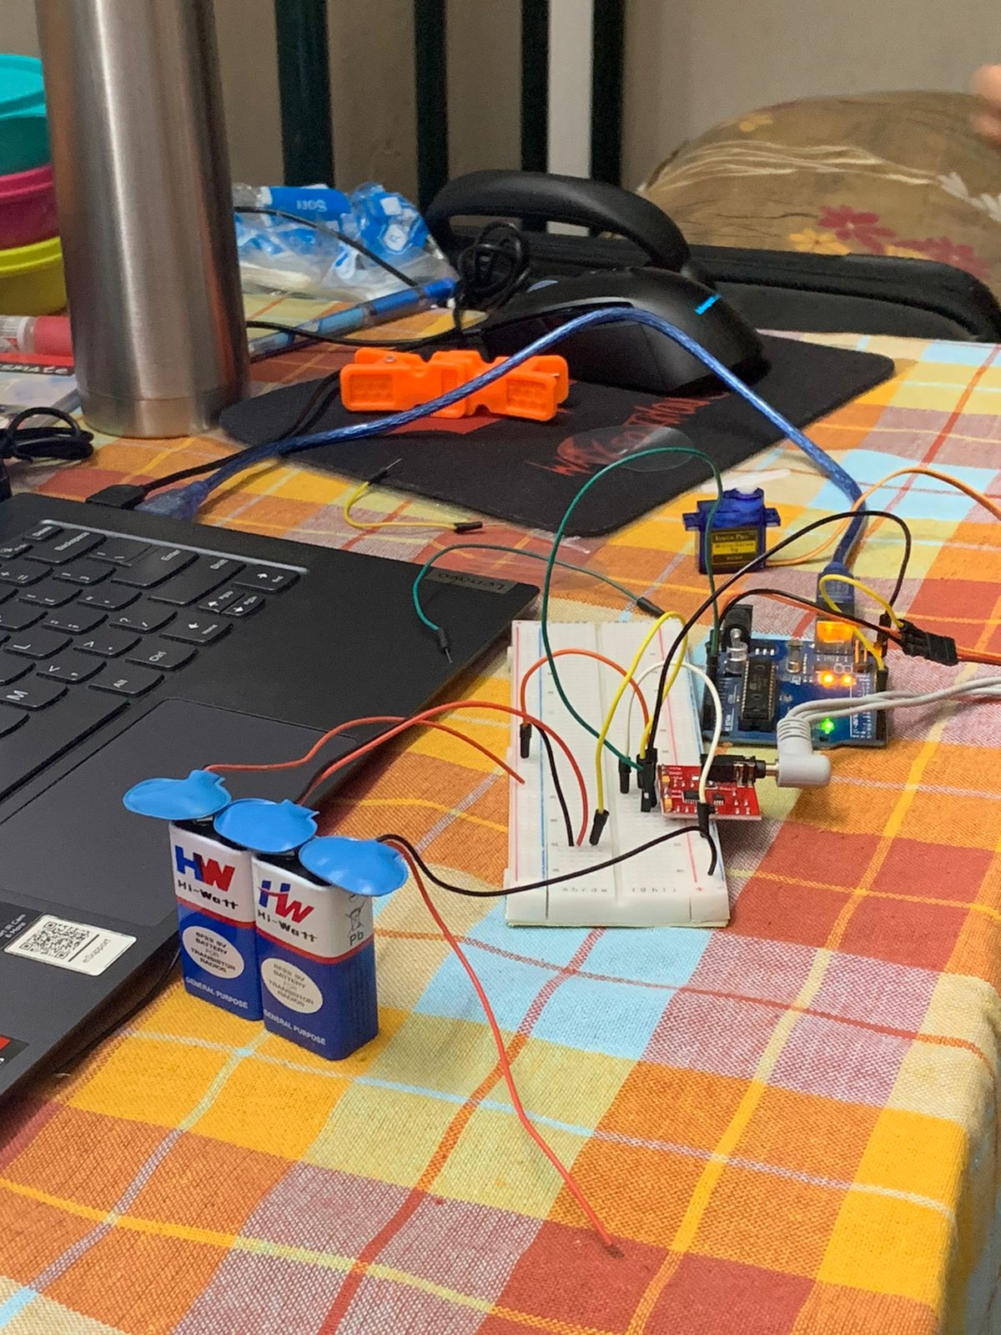
08

Slide 8
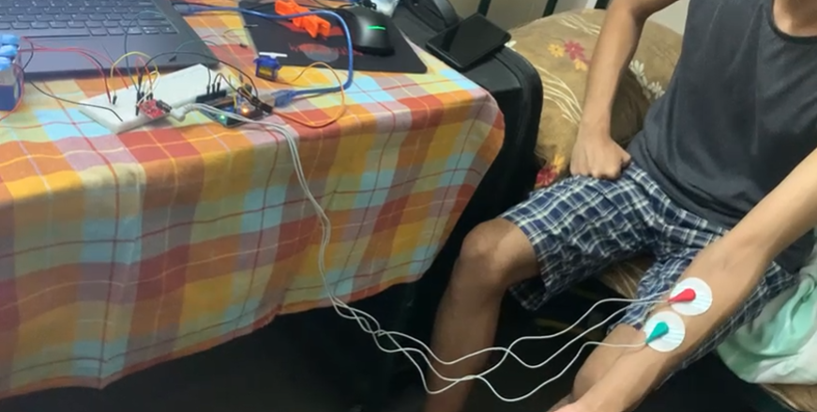
08

Slide 9
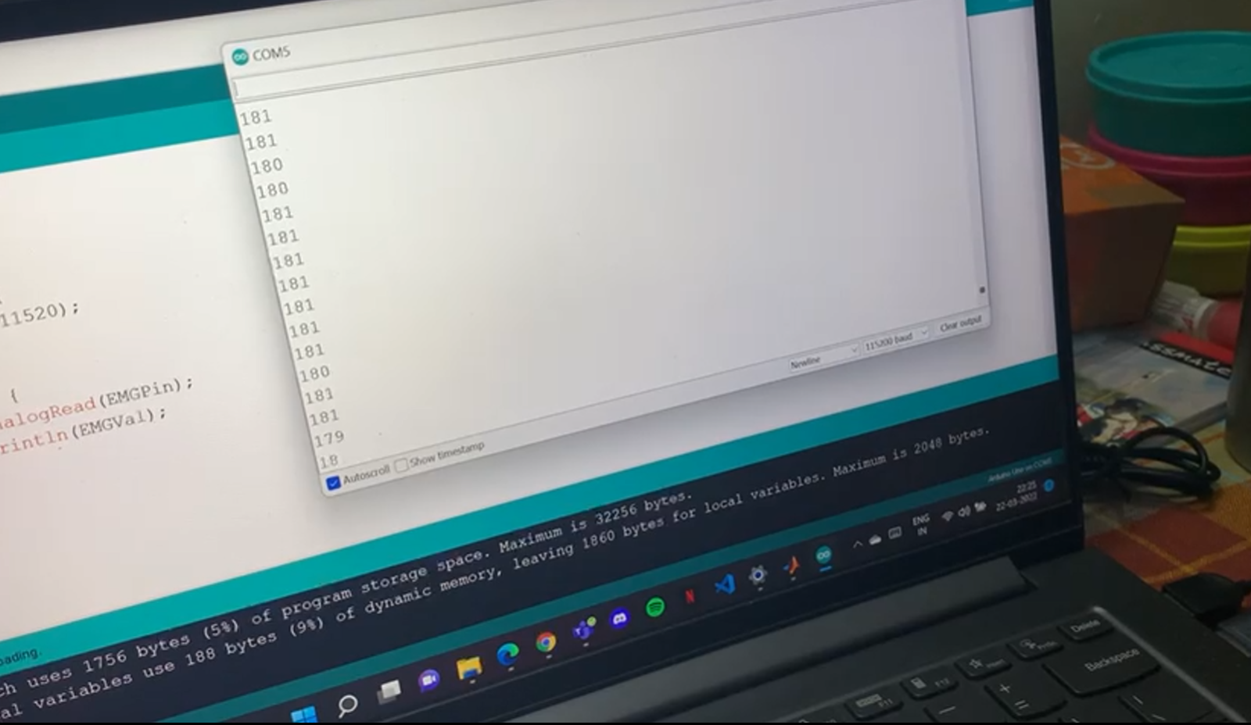
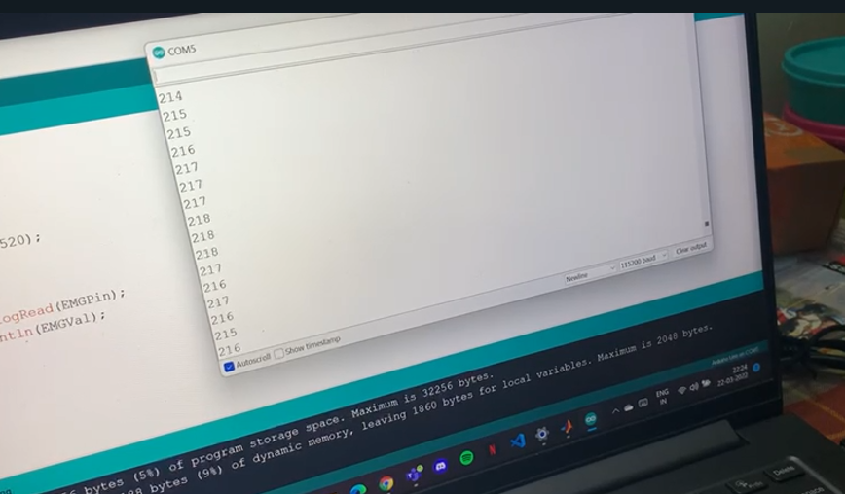
09

Slide 10
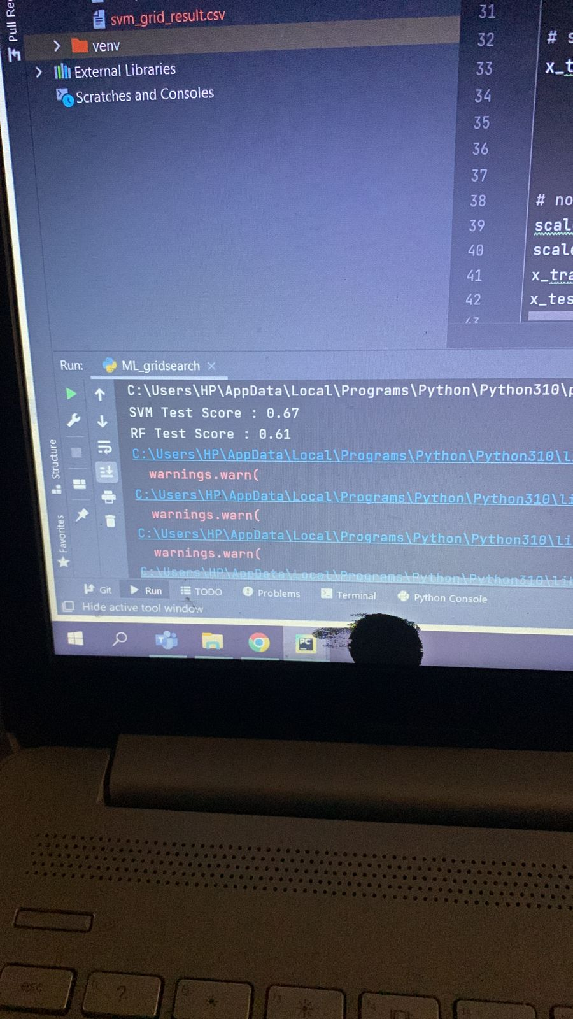
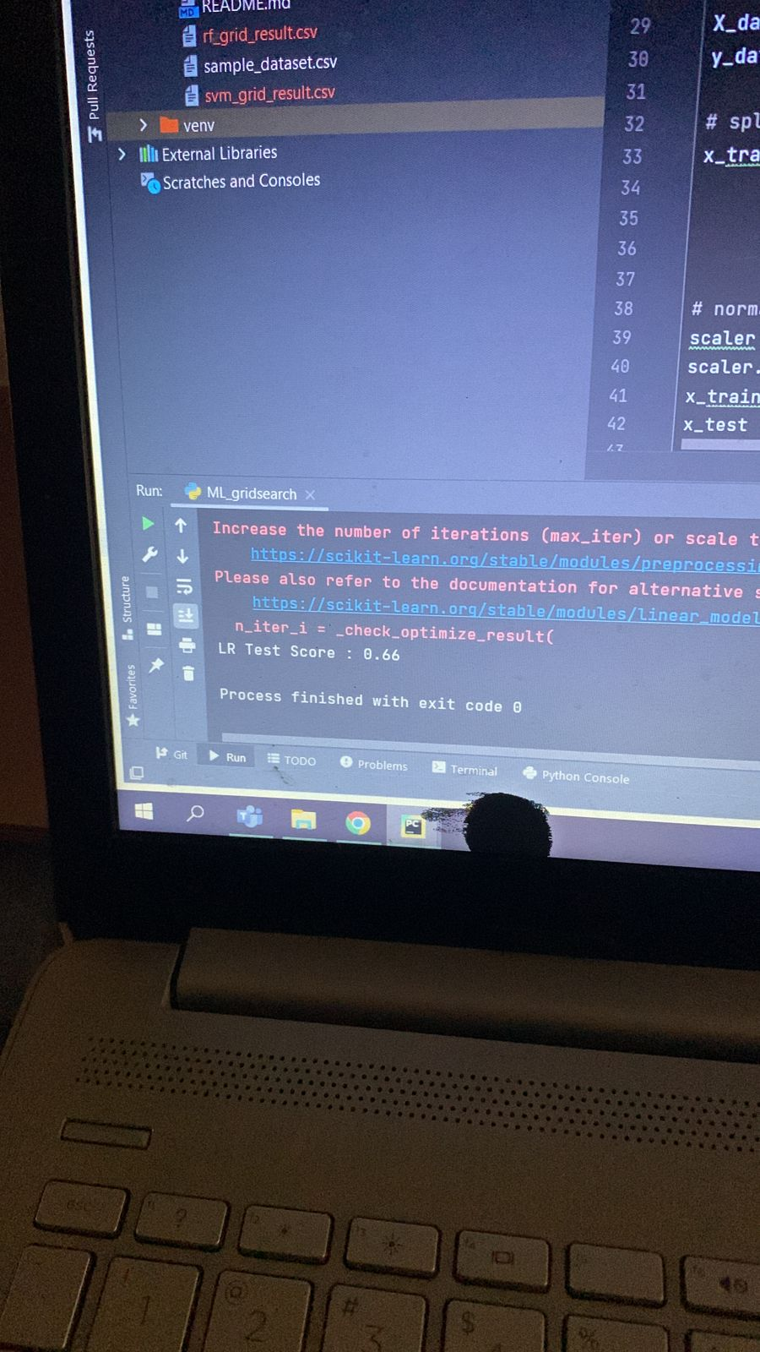
06

Slide 11
RESULT:
06
We are succeeded on finding on sensing the almost EMG data from the V3.0 sensor
We analysed the data and created a data set having all the graphical data which we attained from microprocessor
We used Machine learning, LR, SVM grid search models in order to sort.

Slide 12
07
ELDERLY PEOPLE
SPORTS ATHLETES
PEOPLE WITH MILD TO MODERATE MUSCLE
TARGETTED AUDIENCE:
DISCOMFORT
PEOPLE SUFFERING FROM MUSCLE DISORDERS, SUCH AS MUSCULAR DYSTROPHY, MYASTHENIA GRAVIS , RADICULOPATHIES, CARPAL TUNNEL SYNDROME, AMYOTROPHIC LATERAL SCLEROSIS (ALS)

Slide 13
08
HTTPS://LINK.SPRINGER.COM/ARTICLE/10.1007/ S11517-021-02466-Z HTTPS://ONLINELIBRARY.WILEY.COM/DOI/ABS/1 0.1002/CPE.6051 HTTPS://IEEEXPLORE.IEEE.ORG/ABSTRACT/DOC UMENT/9521161
https://www.pololu.com/file/0J745/Muscle_Sensor_v3_users_manual.pdf
References:

Slide 14
THANK YOU

